Slide 1




[ BOOKLET ]
ENERGY CONSERVATION BUILDING CODE – 2017
FOR PUNJAB
“Reproduced from the
Energy Conservation Building Code 2017”

Slide 2
ENERGY CONSERVATION BUILDING
CODE (ECBC)
CONTENTS
Brief Summary on ECBC 2017
01
Objective of ECBC 2017
02
ECBC Components & Compliance Approaches
03
Building Component
04
Building Envelope
05
Comfort System & Controls
06
Lighting Controls
07
Electrical & Renewable Energy Systems
08
Whole Building Performance Approach
09

Slide 3
ENERGY CONSERVATION BUILDING
CODE (ECBC)
WHAT IS ECBC ?
PURPOSE
Developed by Ministry of Power and Bureau of Energy Efficiency (BEE), ECBC 2017 prescribes the energy performance standards for new commercial buildings to be constructed across India.
The purpose of the ECBC is to provide minimum requirements for the energy-efficient design and construction of buildings.
The code is Mandatory for commercial buildings or building complexes that have a connected load of 100 kW or more or a contract demand of 120 kVA or more.

Slide 4





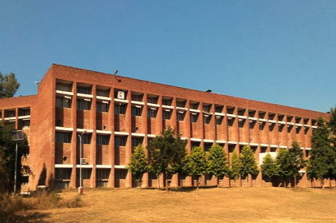

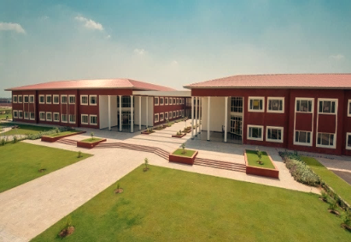
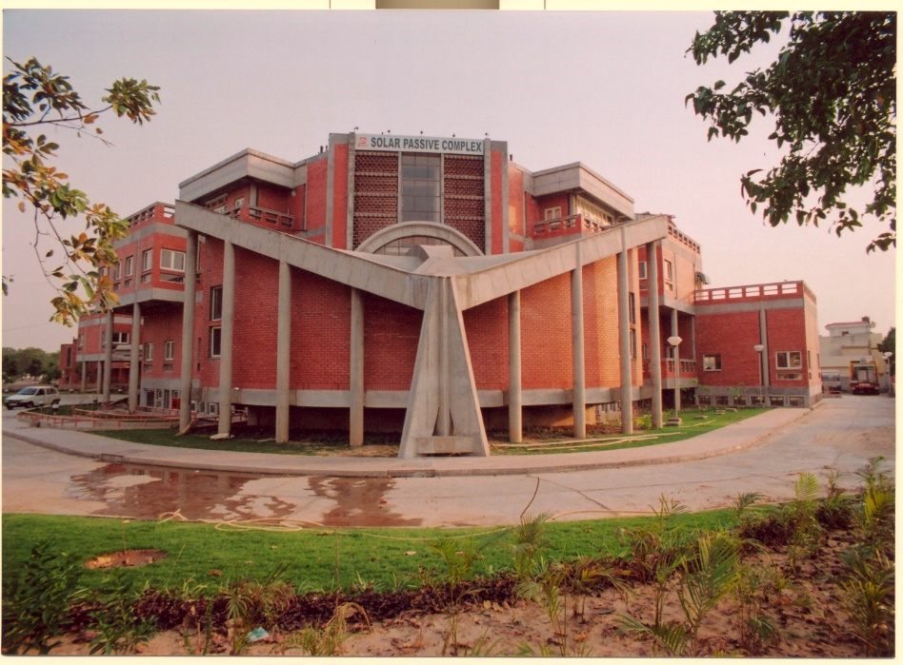
ENERGY CONSERVATION BUILDING
CODE (ECBC)
Building Classification
Any one or more building or part of a building with commercial use is classified as per the functional requirements of its design, construction, and use. The key classification is as below;
Applicable Buildings
HOSPITALITY
SHOPPING
COMPLEX
EDUCATION
BUSINESS
HEALTHCARE
Present Architecture Style in Punjab
With time Punjab has shifted towards more modern and flexible architecture for commercial buildings in the state keeping pace with the rapid ongoing globalization. The Government is also taking up initiatives to promote Green Building concepts and practices in a planned manner within the state. This has expanded the market in Punjab with more and more people gaining awareness. The shift to green and sustainable buildings is occurring gradually. Some photos of modern-day architecture in the State of Punjab are as given below.
Institutional Building, Punjab
Indian School of Business, Mohali
PEDA, Chandigarh
Dera Path Seekers School, Dera Baba Jaimal Singh, Punjab
PEDA, Chandigarh

Slide 5

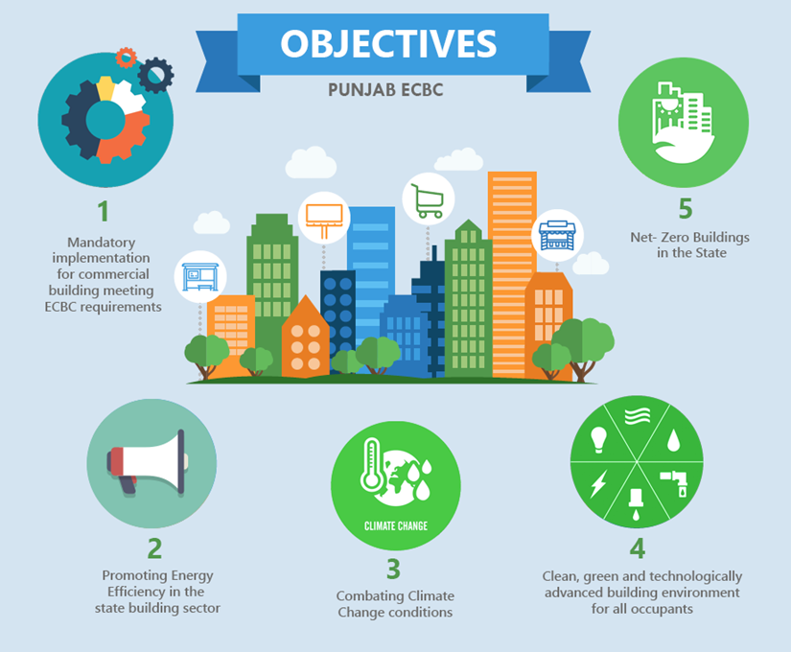
ENERGY CONSERVATION BUILDING
CODE (ECBC)
A Brief Summary on ECBC 2017
ECBC is aiming at reducing the electricity consumption of the state by implementing the code for all commercial buildings meeting the ECBC requirement threshold
The purpose of Energy Conservation Building Code (ECBC) is to provide minimum requirements for energy-efficient design and construction of buildings and their systems. It is mandatory for commercial buildings or building complexes that have a connected load of 100 kW or greater or a contract demand of 120 kVA or greater.

Slide 6
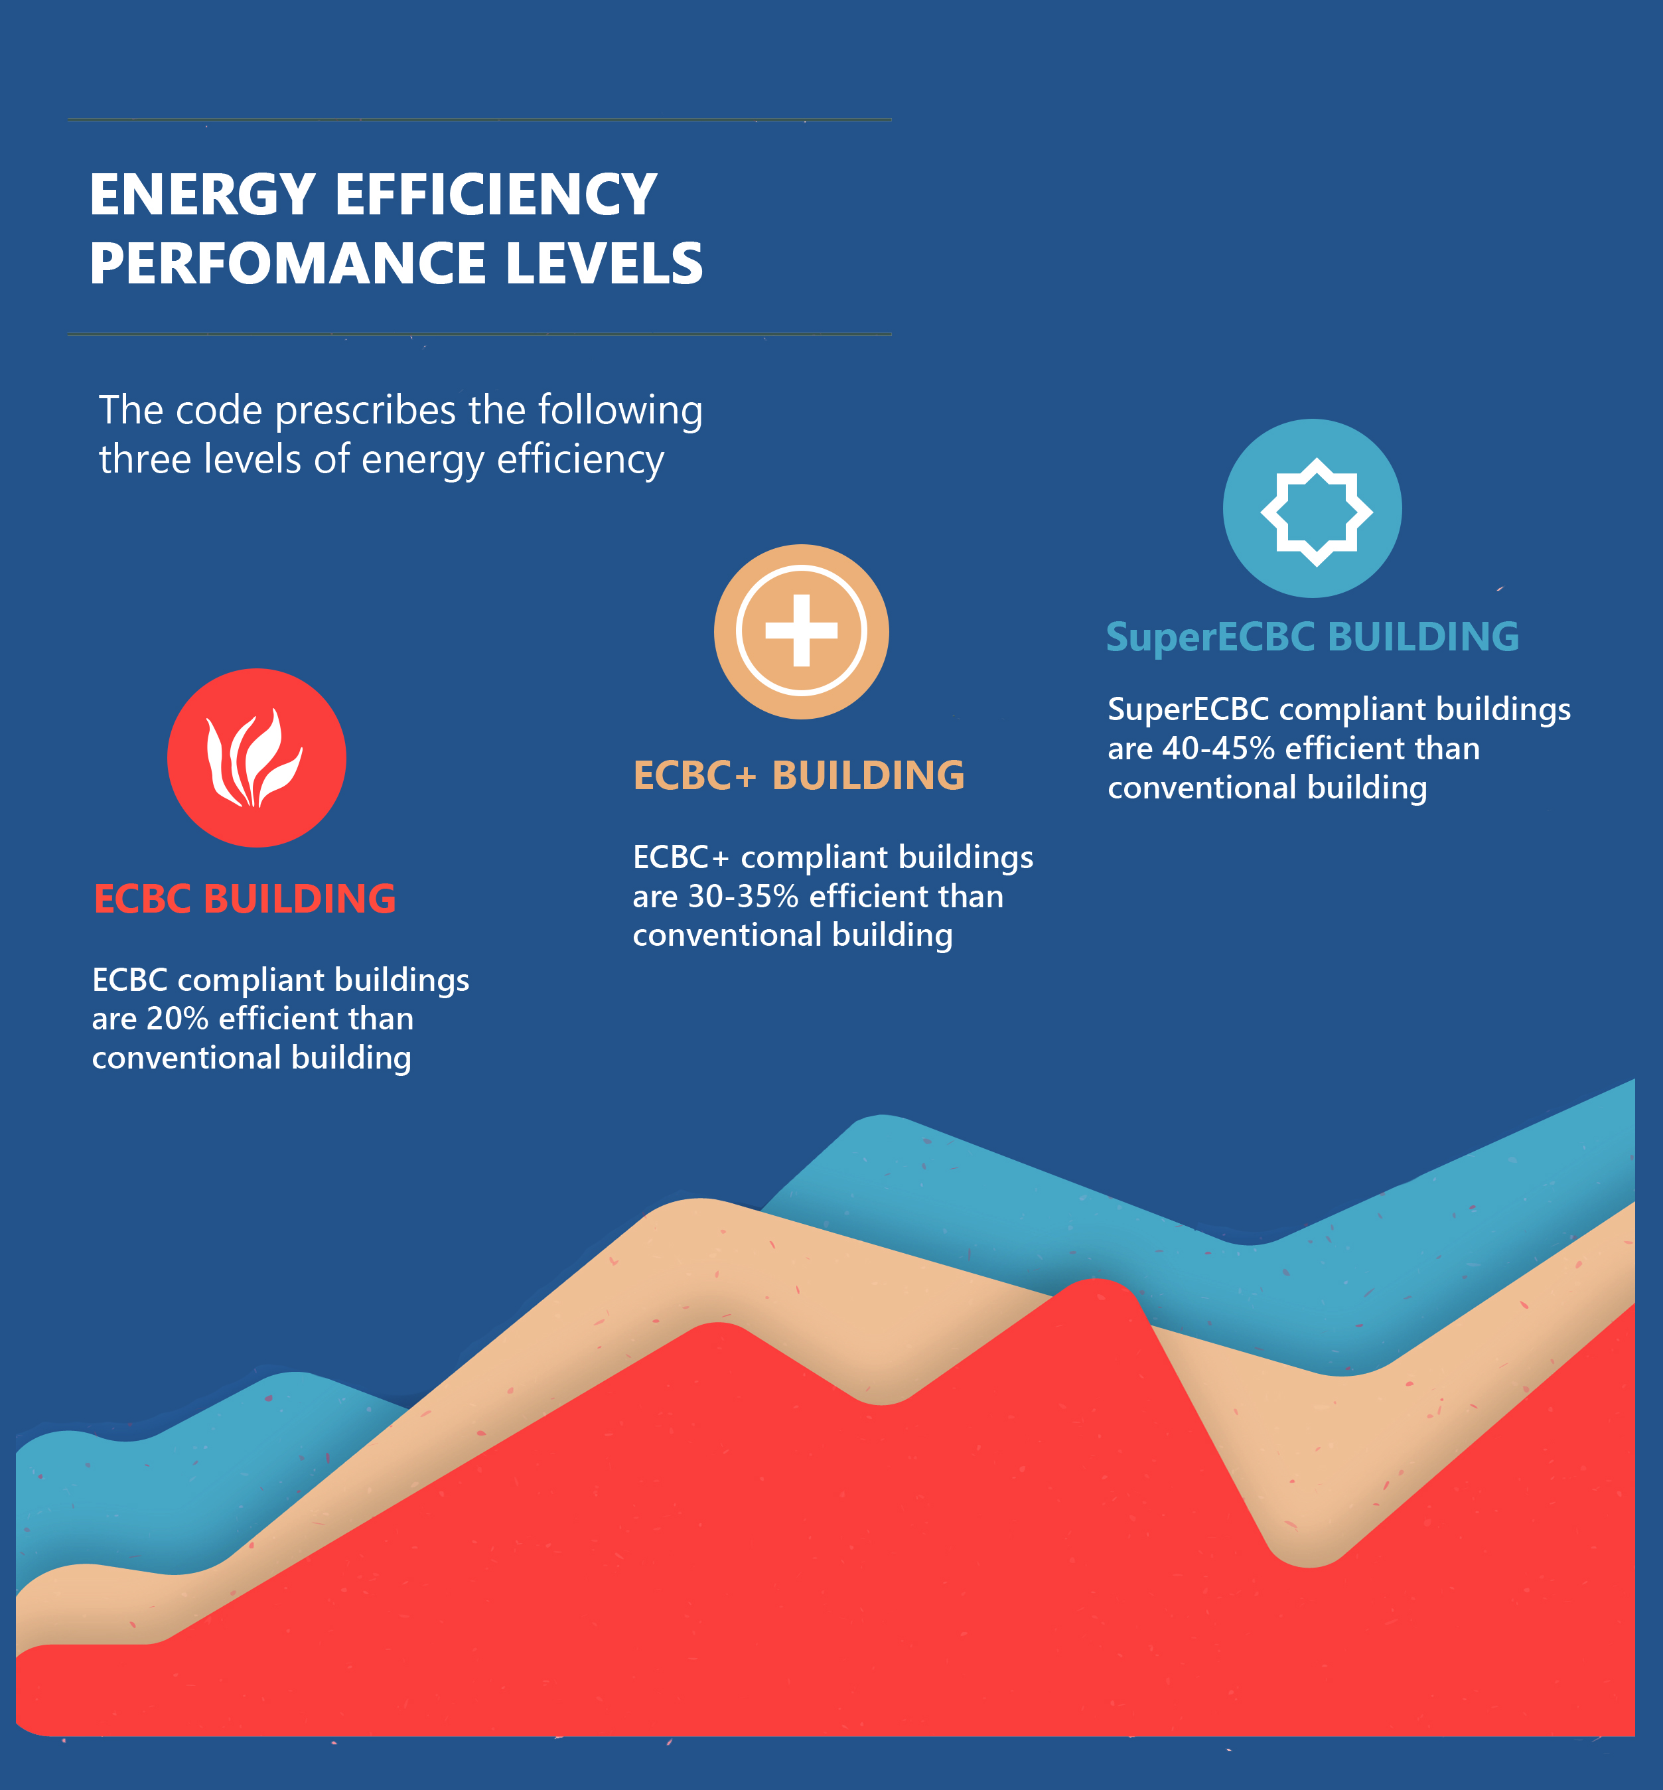
ECBC COMPONENTS & COMPLIANCE APPROACHES
Building Envelope
Comfort Systems and Controls
Lighting and Controls
Electrical and Renewable Energy Systems
Prescriptive
Mandatory Requirement
Trade-off option
(For Envelope Only)
Whole Building Performance
Required for all compliance approaches

Slide 7





ENERGY CONSERVATION BUILDING
CODE (ECBC)
BUILDING COMPONENT
Building components are individual elements that are incorporated in a structure to finally result in creating a habitable space. The main building components that influence the energy efficiency of the building and are focused in the ECBC code are Building Envelope, Lighting, HVAC and Renewable Energy.
ECBC majorly deals with four sections. They are: Building Envelope, Comfort System & Controls, Lighting & Controls, Electrical & Renewable Energy Systems
SECTIONS OF ECBC 2017
BUILDING ENVELOPE
COMFORT SYSTEM & CONTROLS
VARIOUS BUILDING SYSTEM OF
ECBC 2017
LIGHTING & CONTROLS
ELECTRICAL & RENEWABLE ENERGY SYSTEMS

Slide 8
ENERGY CONSERVATION BUILDING
CODE (ECBC)
BUILDING ENVELOPE
(Section §4 of ECBC 2017)
Building envelope comprises of Vertical fenestrations, Opaque constructions (walls) and Roofs
Envelope is a physical separator between the occupied spaces and the external environment. Majority of the heat gain occurs in a building by means of convection through the envelope which includes walls, roofs and fenestrations.
PRESCRIPTIVE REQUIREMENTS
MANDATORY REQUIREMENTS
ROOF
U - Factor
FENESTRATION
COOL ROOFS
U- Factor, SHGC, VLT
OPAQUE CONSTRUCTION
OPAQUE EXTERNAL WALL
U-Factor
U - Factor
DAYLIGHTING
VERTICAL FENESTRATION
Simulation Method, Manual Daylighting Calculation
WWR, VLT, U - Factor, SHGC
AIR LEAKAGES
SKYLIGHT
U-Factor, SHGC
GLOSSARY
The Solar Heat Gain Coefficient (SHGC) is a number assigned to a window that tells you how much heat that window lets pass into your home from the sun. SHGC numbers range from 0 to 1, and the lower the number, the less heat will enter your home. Thus, in hot climates a low SHGC is desirable, while in cold climates a higher SHGC is desirable.
Visual Light Transmittance (VLT) refers to the fraction of visible light transmitted through the glazing. VLT is concerned with the visible portion of the solar spectrum.

Slide 9
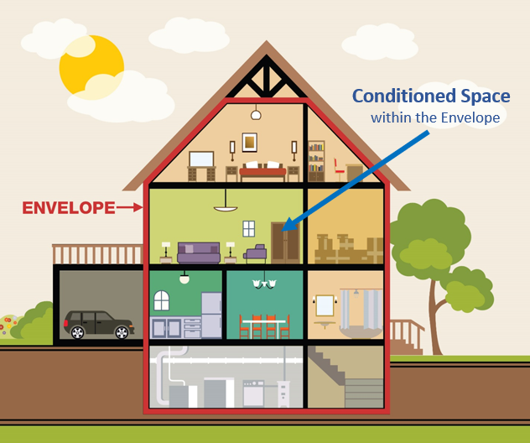
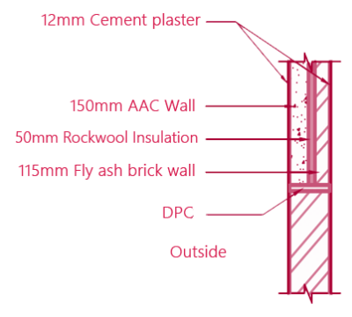
ENERGY CONSERVATION BUILDING
CODE (ECBC)
BUILDING ENVELOPE MINIMUM REQUIREMENTS
VALUE
Maximum Roof U value for all buildings
*[Exceptions exist]
0.33 W/m² K
Maximum External U value for all buildings *[Exceptions exist]
0.40 W/m² K
VLT≥0.27
Max U-Value – 3 W/m² K
Max SHGC – 0.27
Vertical Fenestration
Skylight Roof Ratio
5%
Layer Name | Thickness (L) (m) | Conductivity (K) (W/m K) | Resistance (L/K)
Surface Film Resistance |  |  | 0.1
Cement Plaster | 0.012 | 0.721 | 0.017
Fly Ash Brick | 0.115 | 0.639 | 0.180
Rock Wool | 0.050 | 0.033 | 1.515
AAC Blocks | 0.150 | 0.184 | 0.815
Cement Plaster | 0.012 | 0.721 | 0.017
Surface Film Resistance |  |  | 0.04
U-Value (W/m²K) (1/Resistance) |  | 0.373

Slide 10










ENERGY CONSERVATION BUILDING
CODE (ECBC)
COMFORT SYSTEMS AND CONTROL (Section §5 of ECBC 2017)
HVAC systems are used for heating, ventilation and air conditioning of the spaces and are the reason for about 60% of the electricity consumption both in the form of electricity and fuel use. Selecting energy efficient and high BEE Star Rated HVAC systems are given much importance in ECBC.
Heating
HVAC
Ventilation
Air Conditioning
Mandatory Requirements
The code also provides with the technical parameters that the HVAC systems must ensure to achieve maximum savings over the operation period of the building.
Natural
VENTILATION
Mechanical
Mixed Mode
Chillers
Prescriptive Requirements
VRFs
Pumps
Fans
Cooling Towers
Economizers
Variable Flow Hydronic System
Boilers
Energy Recovery
MIN. EFFICIENCY
Air Conditioning
Condensing Units
Time Clock
Temperature
CONTROLS
Occupancy
Fan
Dampers
Piping & Ductwork
System Balancing
Condensers
Service Water Heating

Slide 11




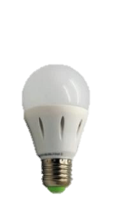

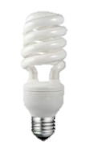





ENERGY CONSERVATION BUILDING
CODE (ECBC)
LIGHTING AND CONTROLS
(Section §6 of ECBC 2017)
Lighting controls is the easiest method to
provide energy savings.
Lighting is known to consume about 20-30% of the total energy consumption in buildings. The ECBC encourages the use of energy efficient lighting equipment and design practices by assisting lighting power allowances to both interior and exterior lighting systems.
AUTOMATIC CONTROL SHUTOFF
Lighting consumes about 20-30% of the total building energy consumption.
LIGHTING
CONTROLS
SPACE
CONTROL
Direct electricity consumption to provide artificial lighting to the building spaces
EXTERIOR LIGHTING
Indirectly by emitting heat which is required to be cooled by the HVAC systems
PRESCRIPTIVE REQUIREMENTS
Interior Lighting Power
Building Area Method
Space Function Method
Installed Interior Lighting Power
Luminaire Wattage
Exterior Lighting Power
ECBC promotes the use of daylighting to meet the Lux level requirements of the building users.
9 Watts
20 Watts
100 Watts
=
=
A trade-off approach between the WWR and artificial lighting is usually employed by building designers.

Slide 12
ENERGY CONSERVATION BUILDING
CODE (ECBC)
ELECTRICAL SYSTEMS
(Section §7 of ECBC 2017)
The requirements of the electrical power, apply
to all power distribution systems in buildings
that the ECBC standard covers.
All the electrical systems installed in a building such as Distribution Transformer, Electric Motors, DG Set, UPS, Power Factor Controller, Electrical Metering and Electrical Monitoring
Mandatory Requirements
Distribution Transformers
Energy Efficient Motors
Diesel Generators (DG) Sets
Check Metering and Monitoring
Power Factor (PF) Correction
Power Distribution Systems
Uninterruptible Power Supply (UPS)
Renewable Energy Systems

Slide 13
ENERGY CONSERVATION BUILDING
CODE (ECBC)
RENEWABLE ENERGY
(Section §7 of ECBC 2017)
Solar PV panels, solar water heaters (comfort system) and geothermal heat pumps are some technologies that can be installed at site.
ECBC promotes the use of renewables and dedicated space for Solar PV installation in a building to generate electricity at the site and making a building self-sufficient.
MINIMUM SOLAR ZONE AREA/RENEWABLE ENERGY GENERATING ZONE REQUIREMENT FOR ECBC+ BUILDING
Building Type | Minimum Electricity to be Generated in REGZ
All building types except below | Minimum 2% of total electrical load
Star Hotel > 20,000 m² | Minimum 3% of total electricity load
Resort > 12,500 m²
University > 20,000 m²
Business >20,000 m²
MINIMUM SOLAR ZONE AREA/RENEWABLE ENERGY GENERATING ZONE REQUIREMENT FOR SuperECBC BUILDING
Building Type | Minimum Electricity to be Generated in REGZ
All building types except below | Minimum 4% of total electrical load
Star Hotel > 20,000 m² | Minimum 6% of total electricity load
Resort > 12,500 m²
University > 20,000 m²
Business >20,000 m²

Slide 14

ENERGY CONSERVATION BUILDING
CODE (ECBC)
WHOLE BUILDING SIMULATION APPROACH
The building undergoing compliance is however needed to meet all the mandatory requirements through sections §4 to §7 (§ 4.2, § 5.2, § 6.2 and § 7.2).
The buildings employing the WBP (Whole Building Performance) method to reach compliance need to have their EPI ratios 1 or less. This means that the energy consumption of the proposed building should be less than that of the Standard building.
Energy Performance Index (EPI) of a building is the annual energy consumption of the building in (kWh/m²/yr). The EPI calculations do not include the unconditioned basement area of the building.
EPI= $\frac{Annual energy consumption in kWh}{Total Built−up Area (excluding unconditioned basements)}$
EPI Ratio of a building is the ratio of the EPI of the proposed building to that of standard building.

Slide 15
ENERGY CONSERVATION BUILDING
CODE (ECBC)
WHOLE BUILDING
PERFORMANCE (WBP)
The alternative approach (Other than Prescriptive approach) to qualify for ECBC is the Whole Building Performance Method. It applies to all buildings of all climatic conditions.
WBP is a flexible approach as it allows the energy analyst to account for measures such as building orientation, natural ventilation, daylighting and high efficiency HVAC system design.
Computer Model compares the Energy Consumption of two designs
ECBC non- compliant Energy Consumption (Proposed Design)
>
Energy Consumption (Standard Design)
ECBC Compliant Energy Consumption (Proposed Design)
≤
Energy Consumption (Standard Design)
Standard Design with ECBC Prescriptive Requirements
Proposed Design with actual Design Specification
Make Changes to Proposed Design
WHOLE BUILDING
SIMULATION
METHOD PATHWAY

Slide 16



Punjab Energy Development Agency
Solar Passive Complex, Plot No. 1 & 2, Sector 33D, Chandigarh – 160034
Phone: 0172-2663382, 28, Fax: 0172-2662865
Website: www.peda.gov.in

